Slide 1

FACIAL EXPRESSION RECOGNITION
Shri Ramdeobaba College of Engineering and Management, Nagpur
Department of Computer Science and Engineering
Session 2022-2023
A Seminar on:

Slide 2
PRESENTED BY:
Group No.: 7
Members:
Chirag Bamb (31)
Harsh Mata (35)
Ved Agrawal (61)
Harshal Dhunde (36)
Project Guide:
Dr. Ramchand Hablani

Slide 3
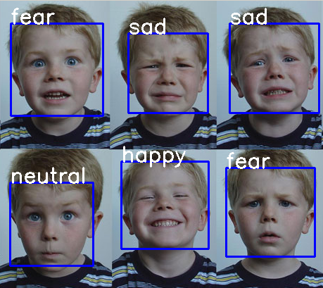
Objective
Facial Expression Recognition using Deep Learning and Analysing the changes in accuracy on different Datasets and different layers

Slide 4
Literature Survey
Sr. No. | Title | Author | Journal/Source | Findings & Relevance | Research Gap
1 | Deep Facial Expression Recognition: | Shan Li and Weihong Deng | IEEE | Using deep neural networks have increasingly been leveraged to learn discriminative representations for automatic FER | Due to lack of proper dataset unable to train model properly
2 | Facial emotion recognition using deep learning: review and insights | Wafa Mellouka, Wahida Handouzia | Tlemcen university, BP 320, Chetouane Tlemcen 1300, Algeria | In this paper we have a detailed study of all model, their innovations and their problems | This analysis of 2019 so there is some ambiguity

Slide 5
Literature Survey
Sr. No. | Title | Author | Journal/Source | Findings & Relevance | Research Gap
3 | Facial emotion recognition with minimal epochs and the significance of data diversity | Tanoy Debnath, Md. Mahfuz Reza, Anichur Rahman, Amin Beheshti, Shahab S. Band & Hamid Alinejad‑Rokny | https://www.nature.com/articles/s41598-022-11173-0 | Using 4- Layer ConvNet CNN Accuracy highly increased | Large and proper dataset. Illumination problems
4 | Deep Facial Expression Recognition: Challenges, Applications, and Future Guidelines | Muhammad Sajjad, Fath U Min Ullah,, Mohib Ullah, Georgia Christodoulou , Faouzi Alaya Cheikh,, Mohammad Hijji , Khan Muhammad, Joel J.P.C. Rodriguesf | Alexandria Engineering Journal | Deep survey on latest issues and all available datasets and models | Now the shift of deep learning to CNN and GAN

Slide 6
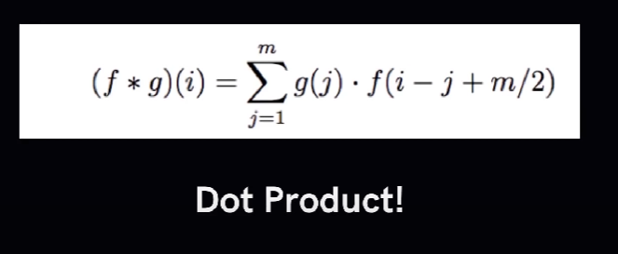
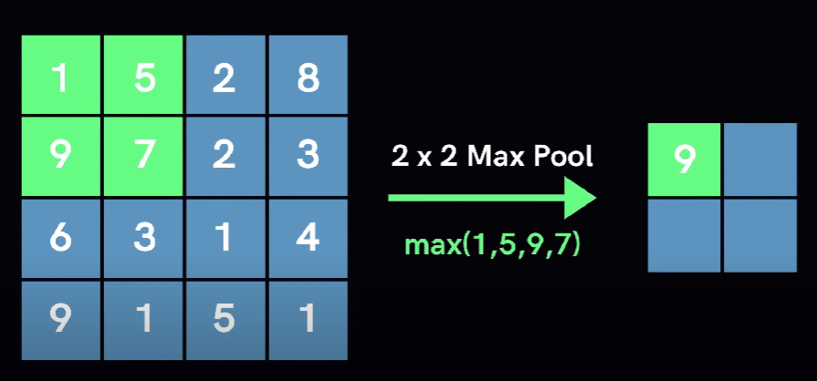
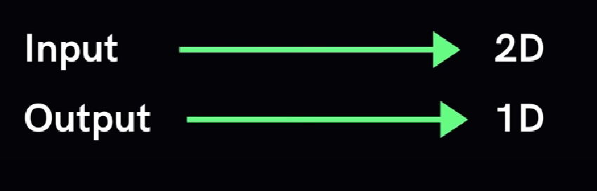
Convolution Neural Network
Allows us to extract visual effects in chunks
Pooling - Reduce The Number of neurons Necessary in subsequent Layers
Two types of polling max-polling and min-polling

Slide 7
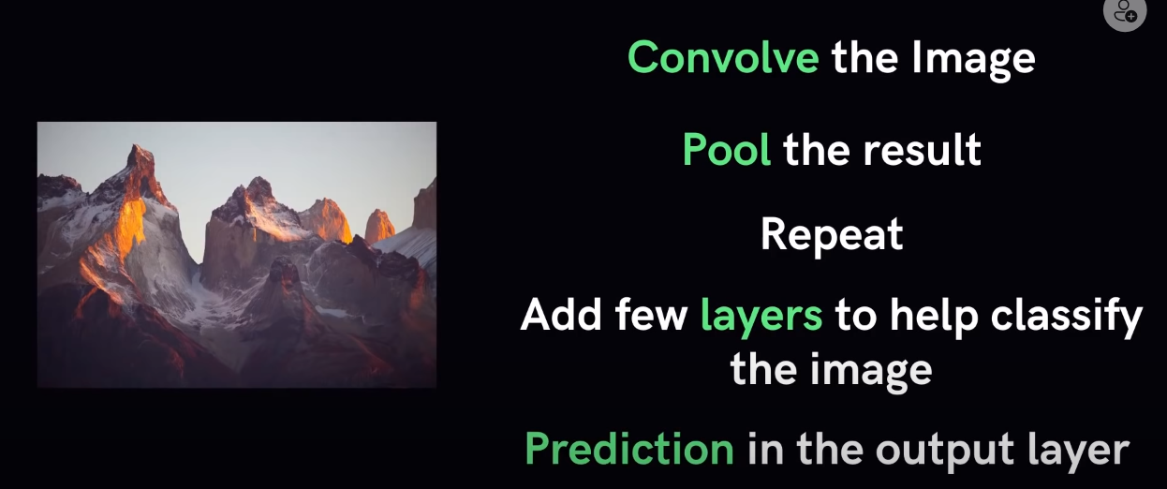
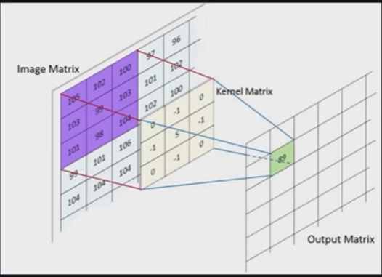

Slide 8

Datasets
Database | Facial Expressions | Sample Details | Type
FER-2013 | Neutral, Sadness, Surprise, Happiness, Fear, Anger, Contempt, and Disgust | 35887 Static Images | Spontaneous
RAF-DB | Angry, Disgust, Fear, Joy, Neutral, Sad, and Surprise | 29672 facial image | Posed
EXP-W | Neutral, Sadness, Surprise, Happiness,Fear, Anger, And Disgust | 91,793 Static Images | Posed

Slide 9
Natural
How Our Models Works
Surprise
Disgust
Testing
Framing
Face Detection
Feature Extraction
Fear
Angry
Sad
Happy

Slide 10
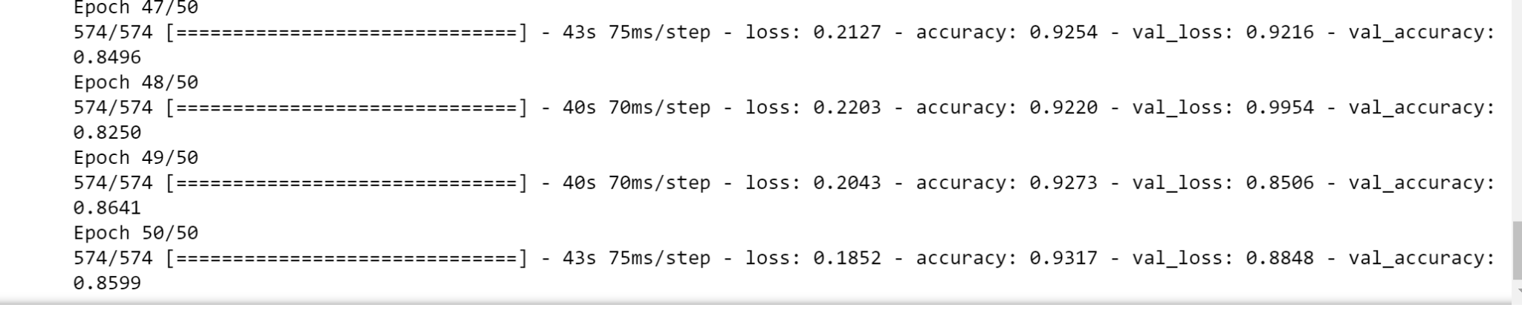
Training and validation Accuracy on FER dataset

Slide 11
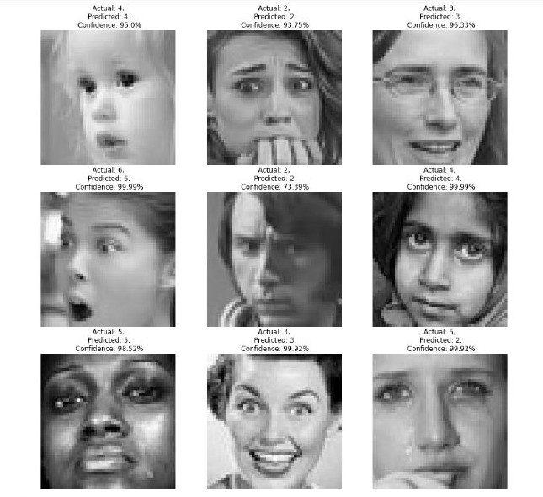
Prediction
On
FER
Dataset

Slide 12
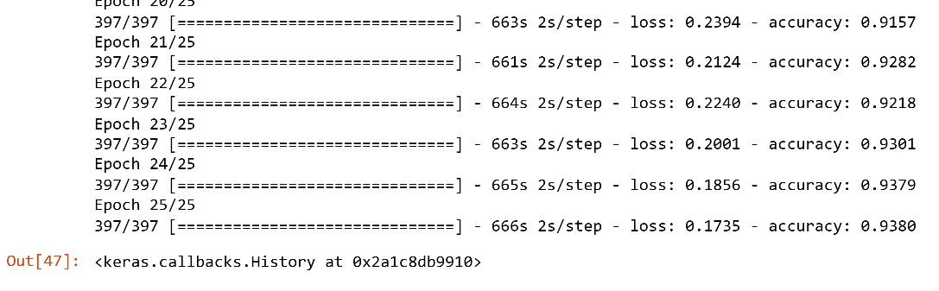
Training and validation Accuracy on Transfer learning model
Using MobileNetV2

Slide 13
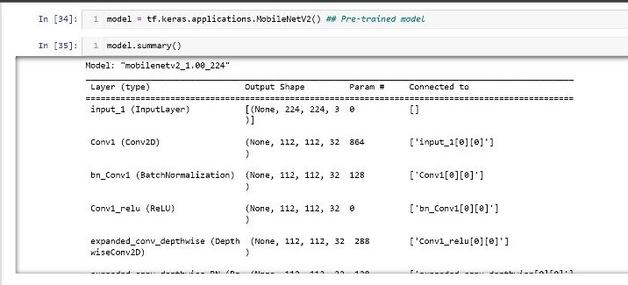
Layer Used in Transfer learning Model

Slide 14
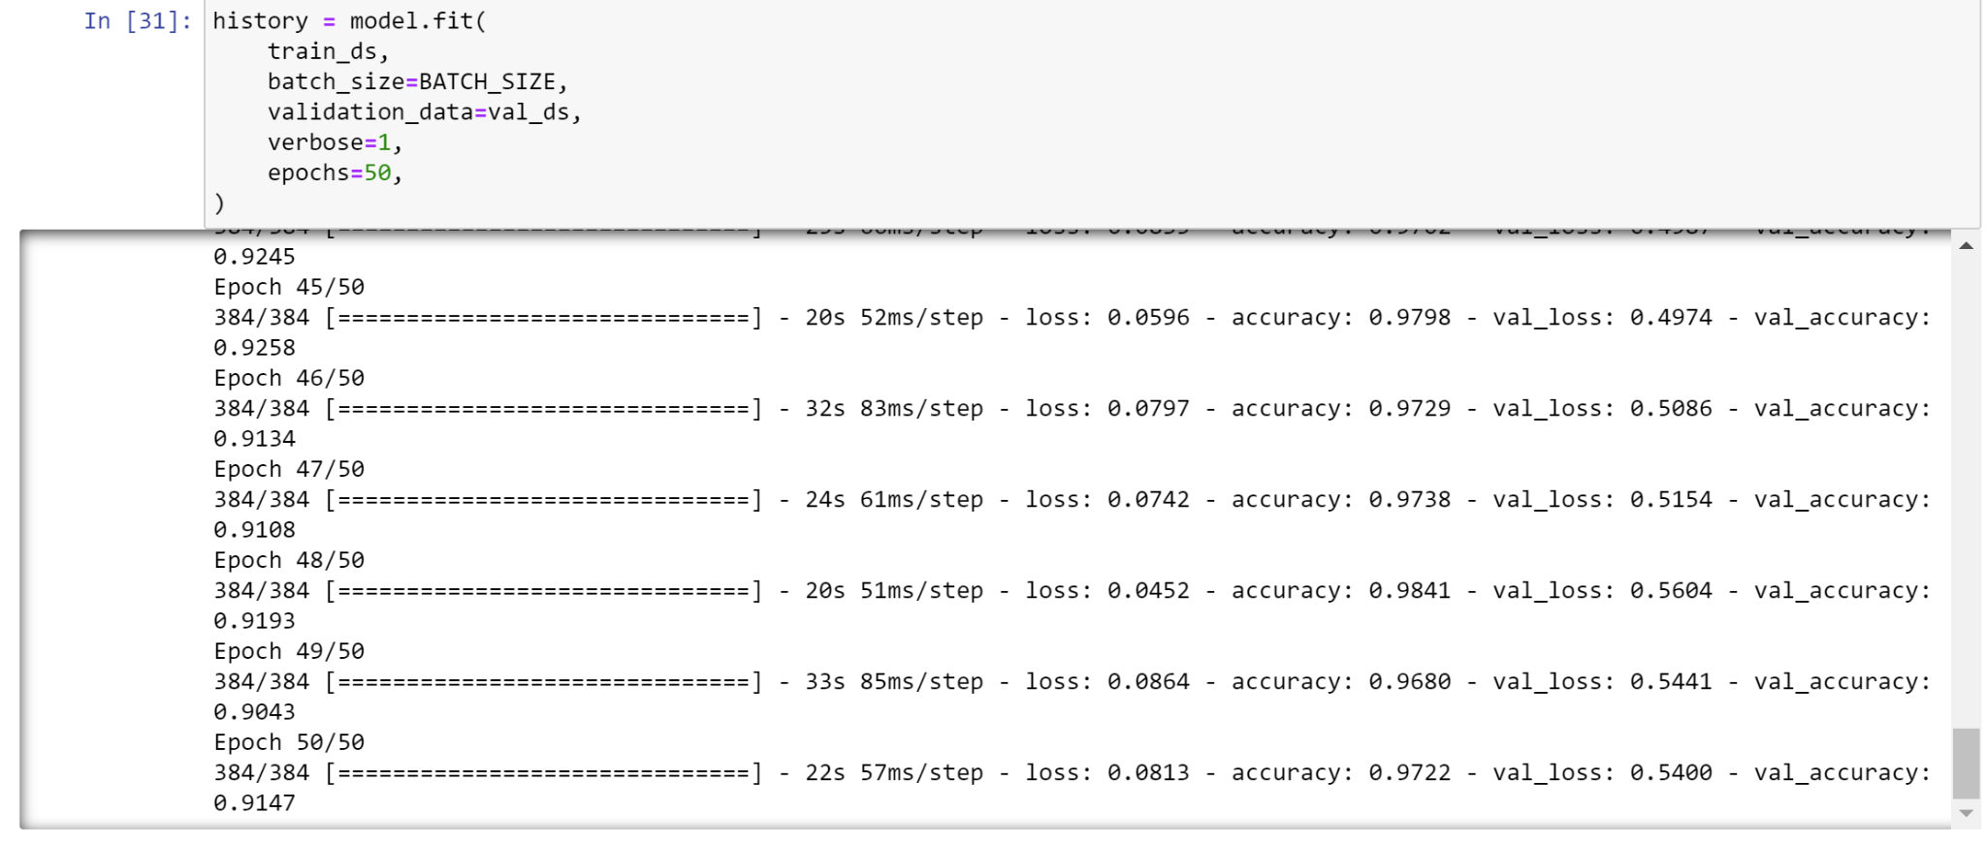
Training and validation Accuracy RAF dataset 48X48.

Slide 15
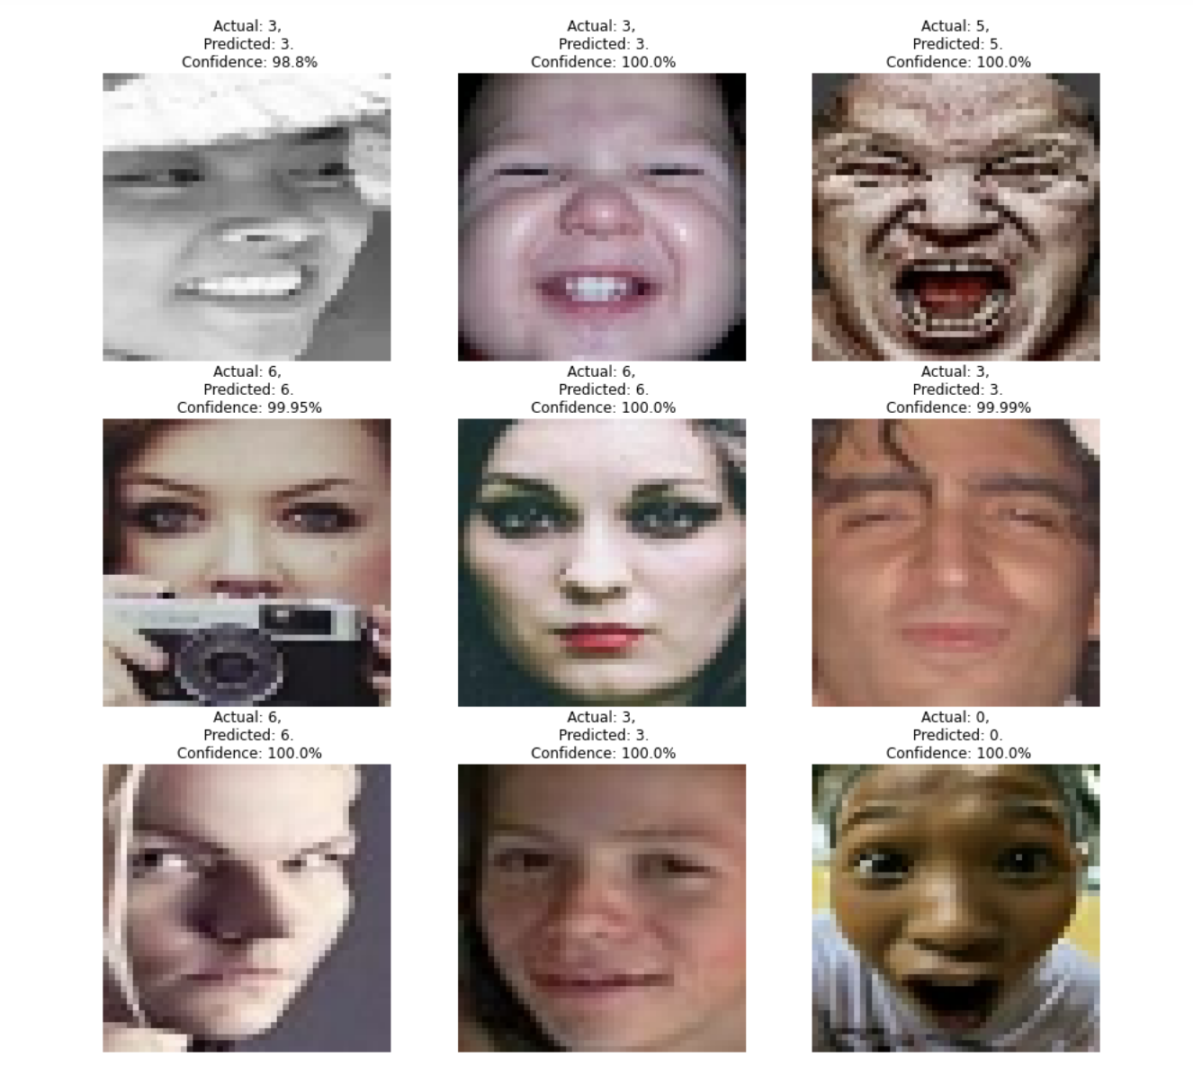
Prediction
ON
RAF dataset 48X48.

Slide 16
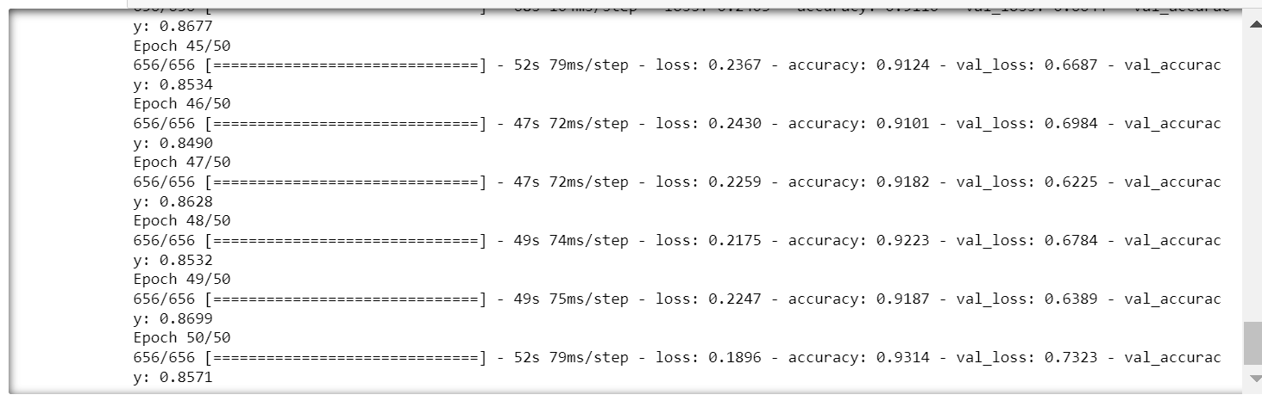
Training and validation Accuracy RAF + FER dataset 48X48.

Slide 17
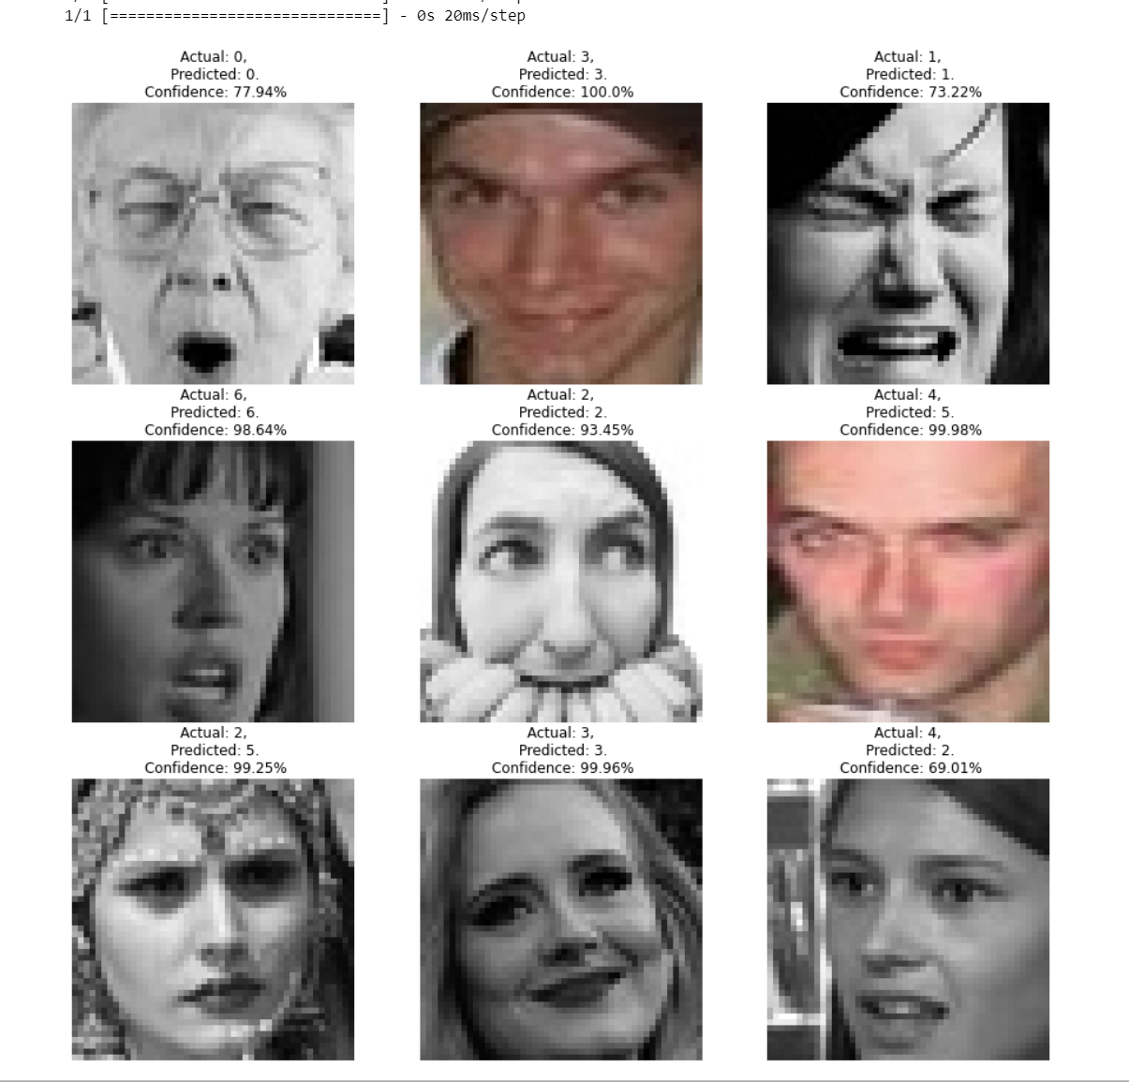
Prediction
ON
RAF + FER
dataset 48X48.

Slide 18
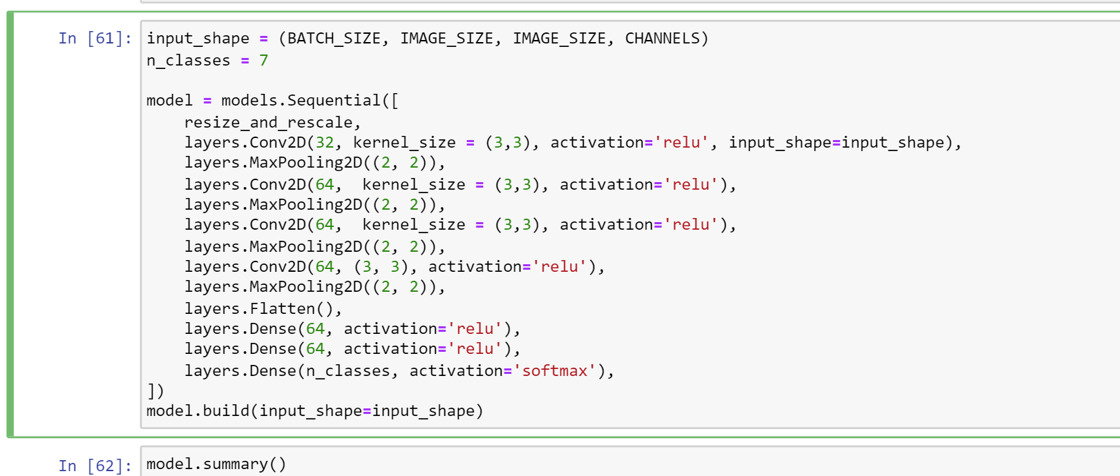
Layers in model on RAF 100 X 100 .

Slide 19
Layers
Convolutional 2D refers to a type of neural network layer that performs a 2D convolution operation. It is commonly used for spatial convolution over images1. The Conv2D class in the Keras API is an example of a 2D convolution layer.
MaxPooling2D is a type of pooling layer that performs a max pooling operation for 2D spatial data. It downsamples the input along its spatial dimensions (height and width) by taking the maximum value over an input window (of size defined by pool_size) for each channel of the input.
Flatten is a term that can refer to several different things. In the context of arrays, it refers to the process of converting a multi-dimensional array into a one-dimensional array
A dense layer is a type of layer in a neural network where each neuron is connected to every neuron in the previous layer. It is also known as a fully connected layer. In Keras, you can create a dense layer using the Dense class from the keras.layers module.

Slide 20
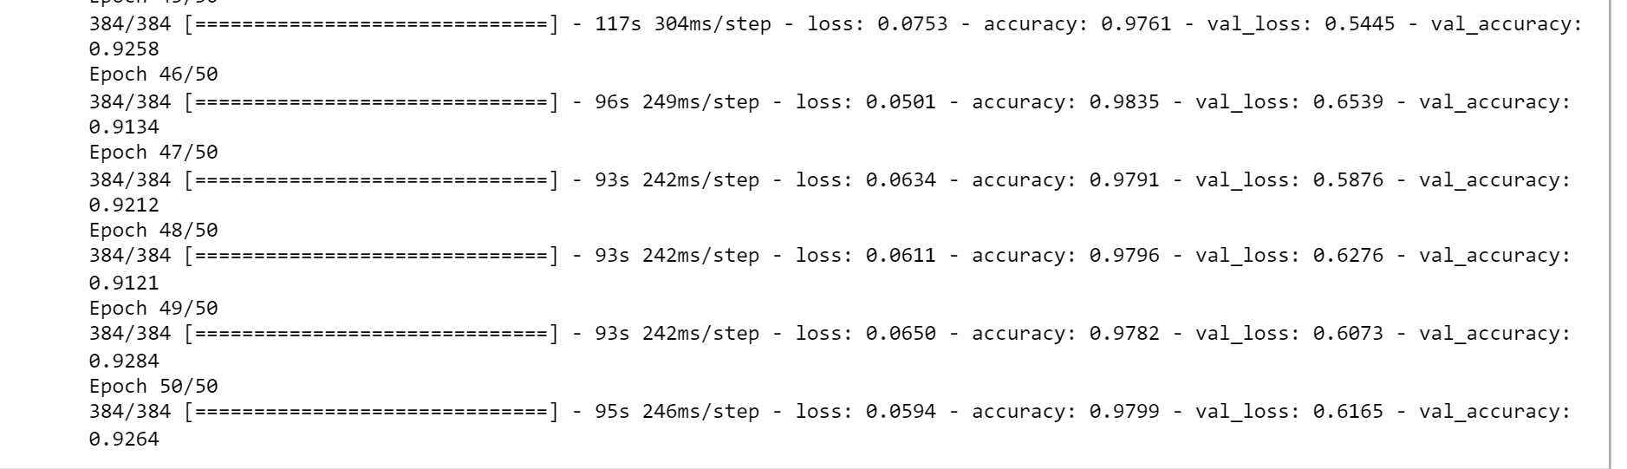
Training Accuracy and Validation accuracy on RAF 100 X 100 .

Slide 21
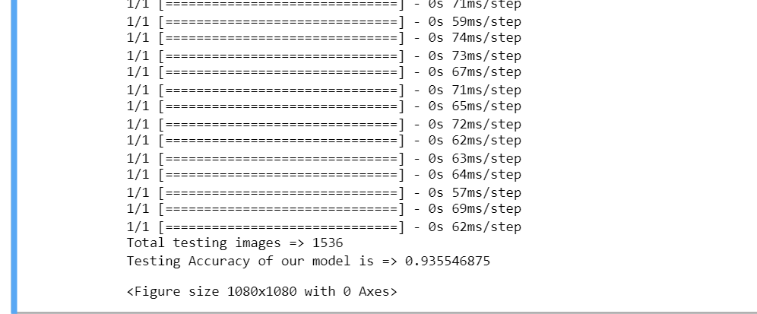
Testing Accuracy on RAF 100 X 100 .

Slide 22
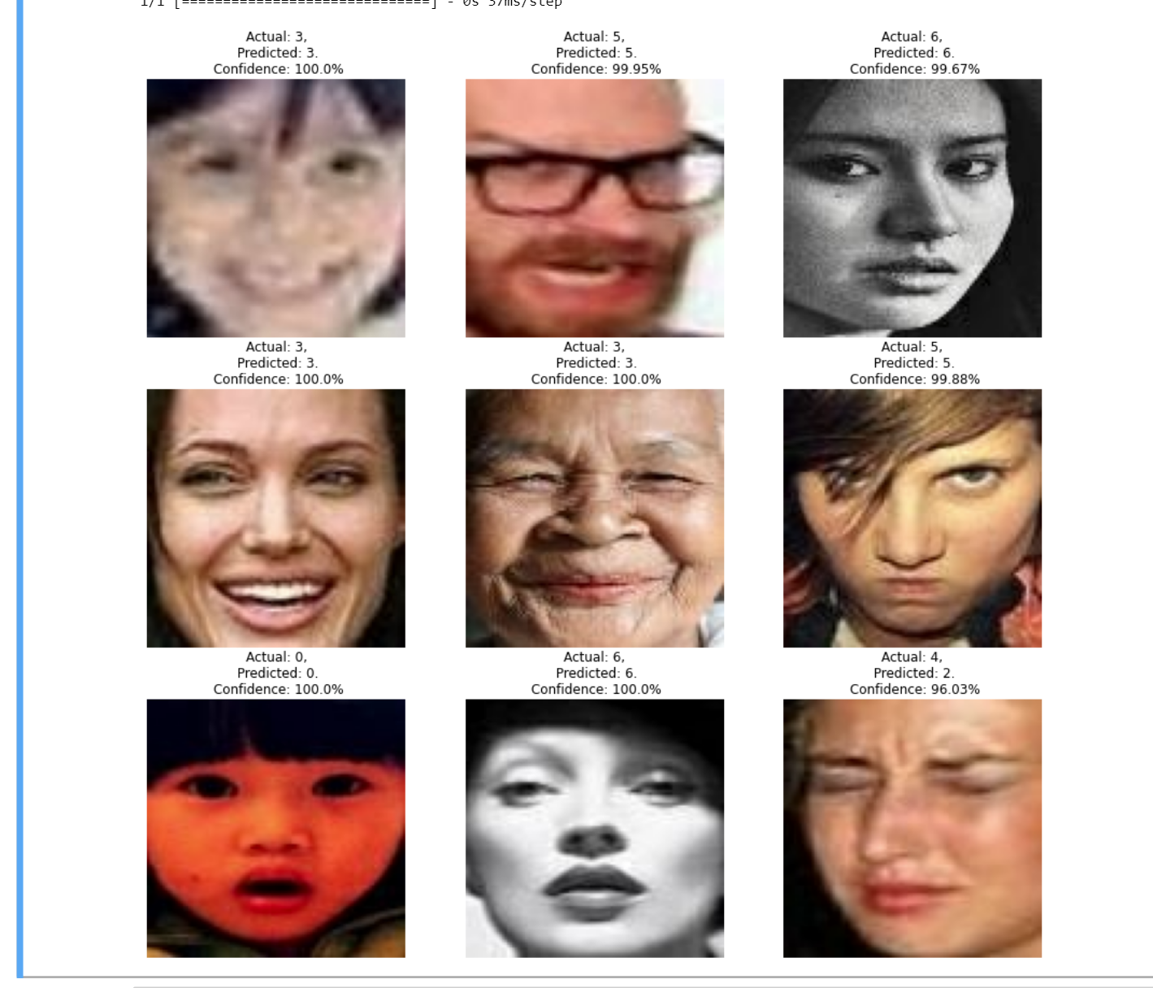
Prediction
On
RAF 100 X 100 .

Slide 23
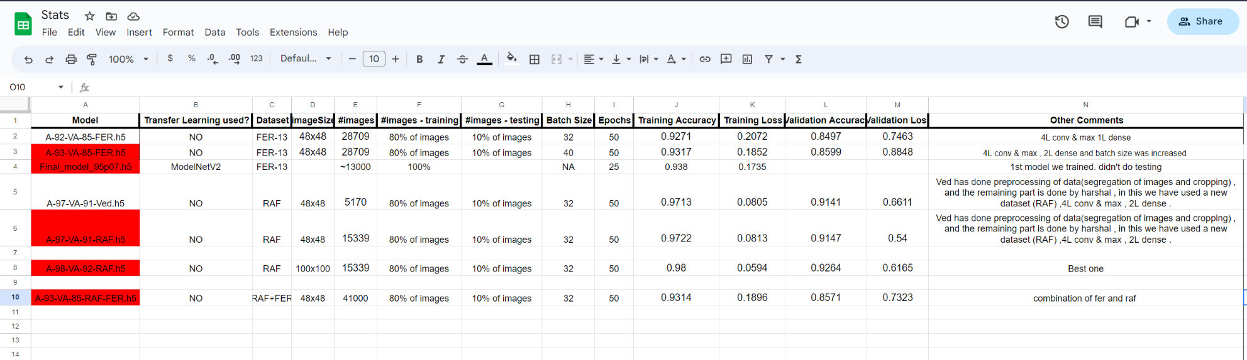
Stats we maintained…

Slide 24
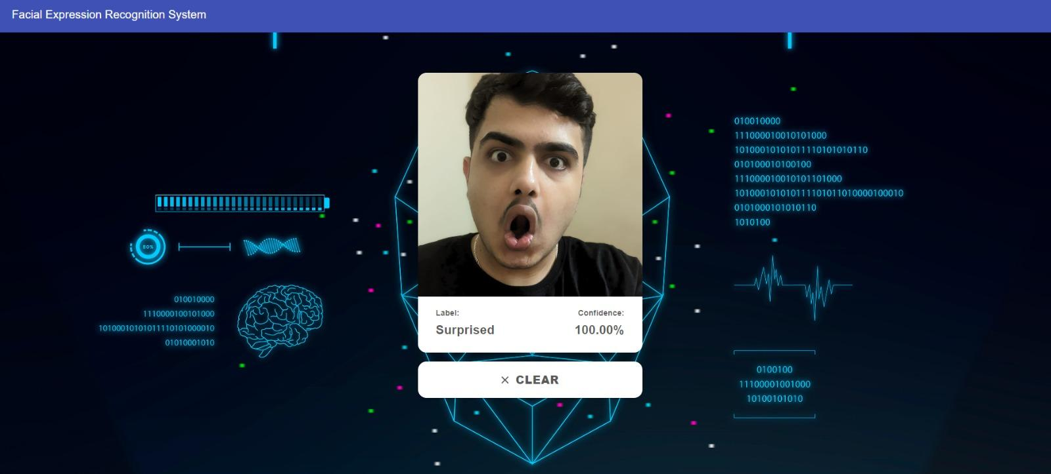
Sample Outputs:

Slide 25
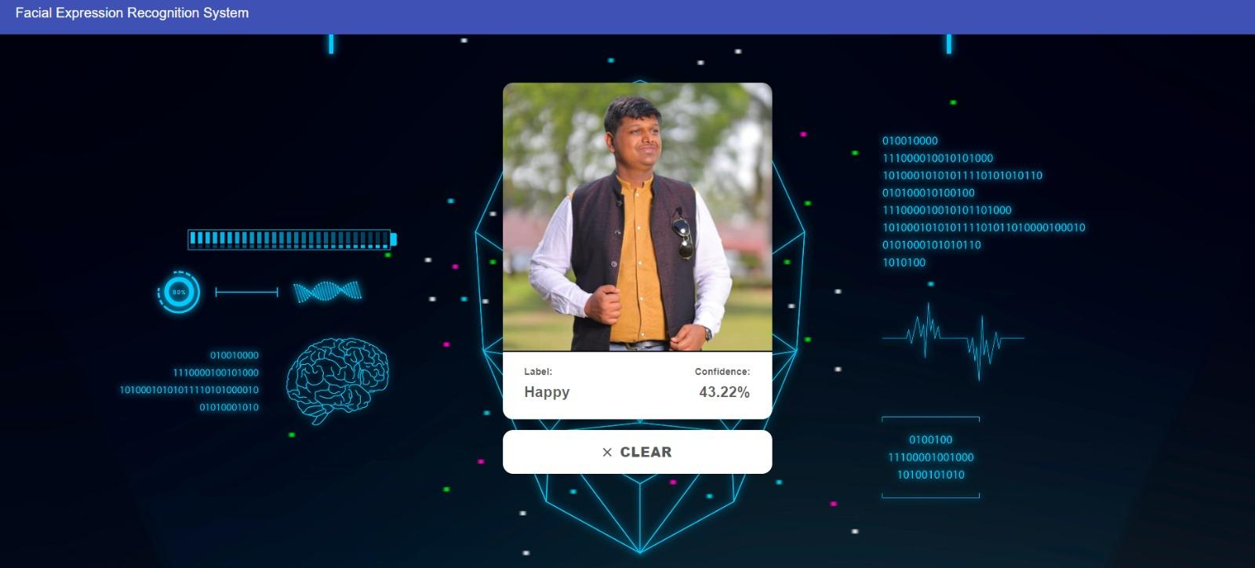
Sample Outputs:

Slide 26
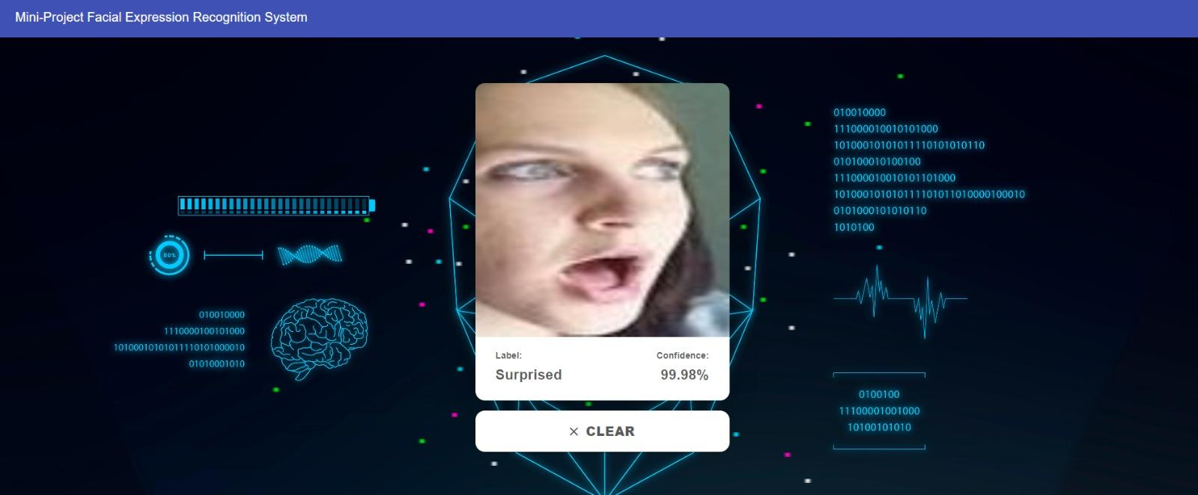
Sample Outputs:

Slide 27
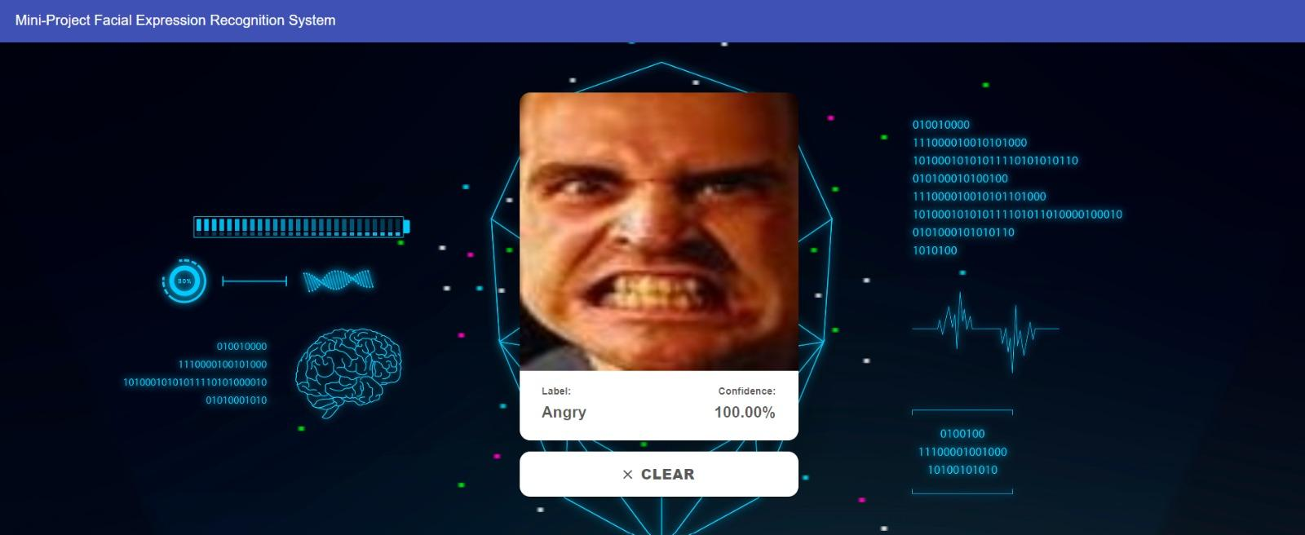
Sample Outputs:

Slide 28
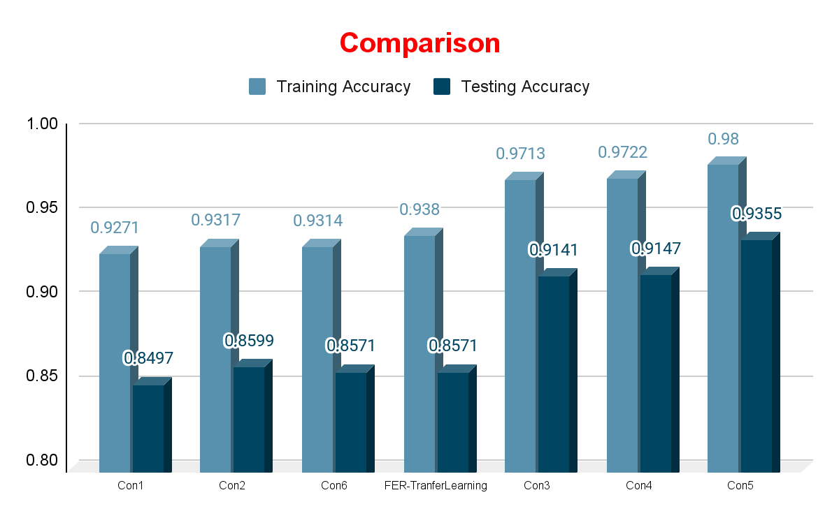

Slide 29
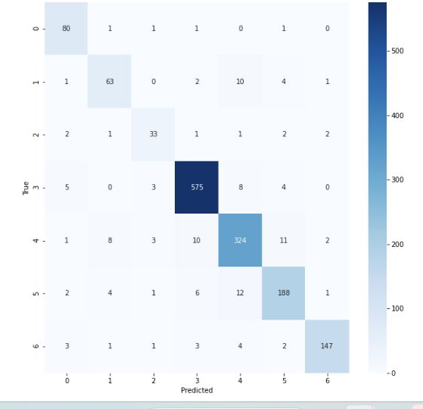
Confusion Matrix

Slide 30
References
Datasets :
FER-2013 [21] :- http://www.consortium.ri.cmu.edu/ckagree/
RaFD [41] :- http://www.socsci.ru.nl:8180/RaFD2/RaFD/
RAF-DB [44], [45] :- http://www.whdeng.cn/RAF/model1.html/
ExpW [47] :- http://mmlab.ie.cuhk.edu.hk/projects/socialrelation/index.html/
Research Papers :
Facial emotion recognition using deep learning: review and insights
Facial Expression Recognition Based on Deep Learning Convolution Neural Network: A Review
Emotional face expression recognition in problematic Internet use and excessive smartphone use: task‑based fMRI study
PTZ-Camera-Based Facial Expression Analysis using Faster R-CNN for Student Engagement Recognition
Four‑layer ConvNet to facial emotion recognition with minimal epochs and the significance of data diversity
A Comprehensive Survey on Deep Facial Expression Recognition: Challenges, Applications, and Future Guidelines
A deep prototypical learning with local attention network for dynamic micro-expression recognition
The Relationship Between Facial Expression and Cognitive Function in Patients With Depression
Fine-Grained Facial Expression Analysis Using Dimensional Emotion Model

Slide 31
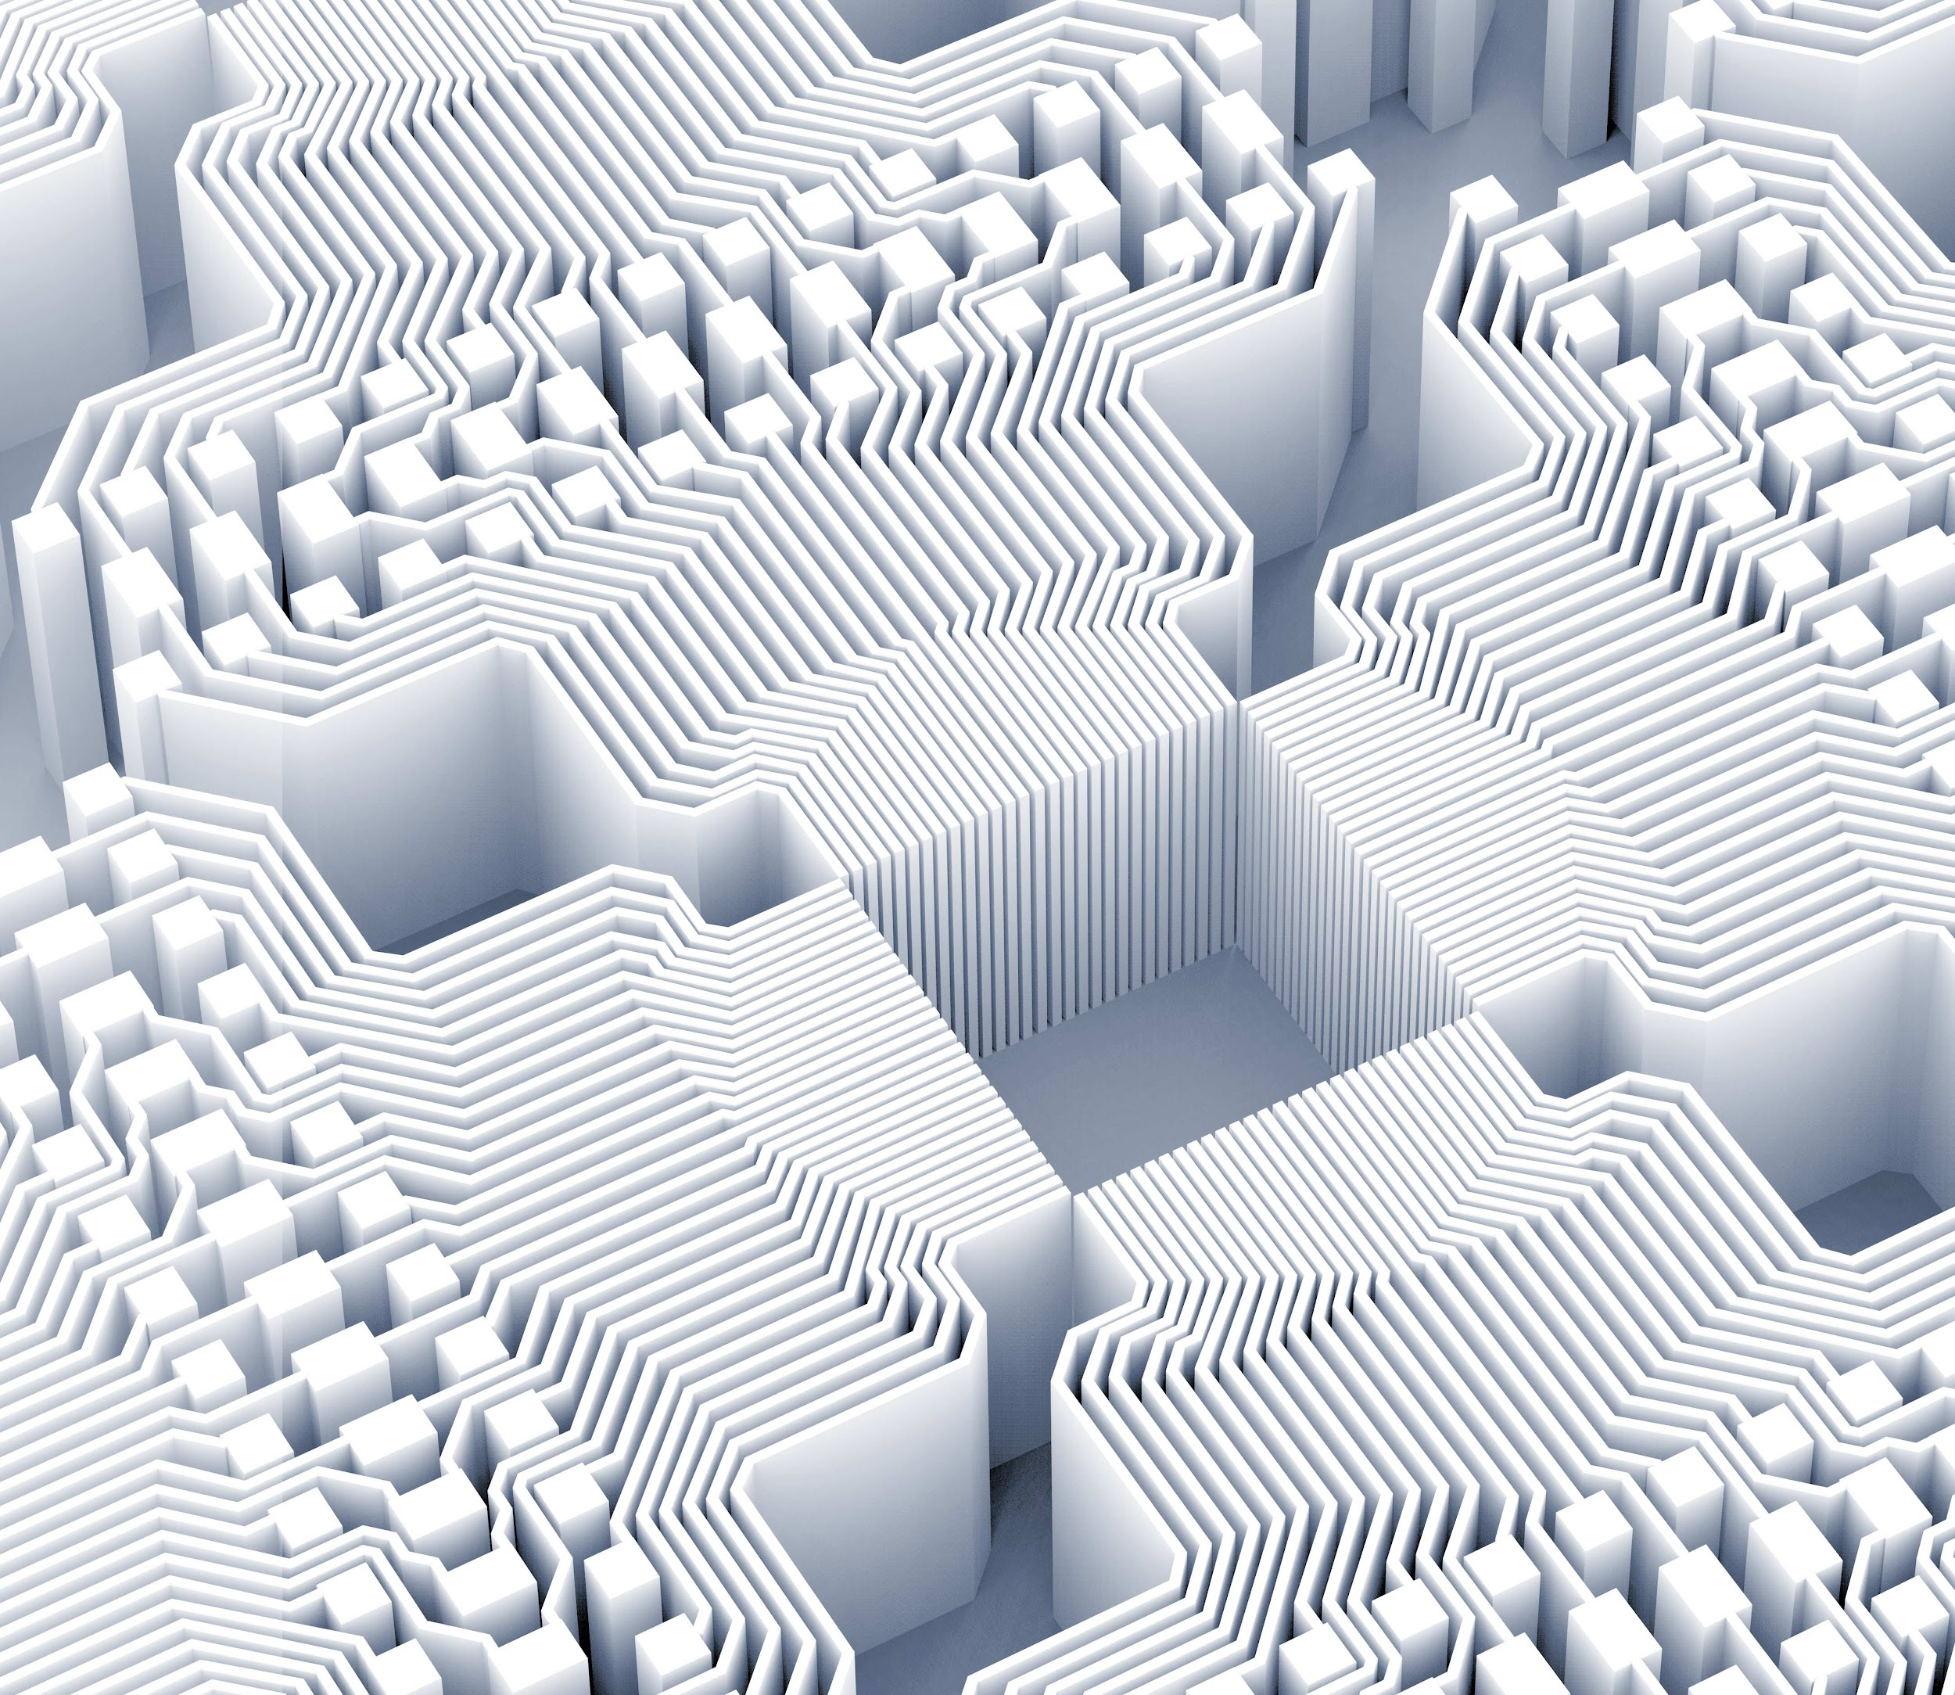
Thank you!

